Slide 1
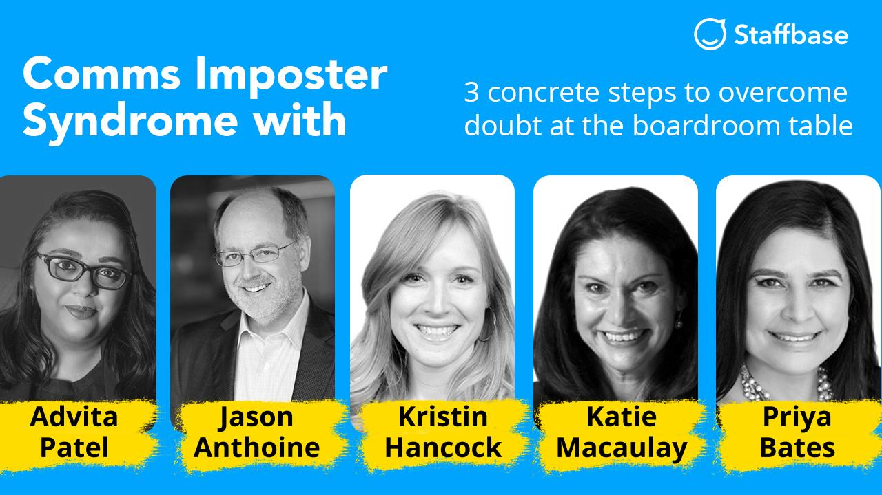

Slide 2
More than 350 Leading Companies Worldwide Reach Their Workforce in Real Time with Staffbase
And they rely on this channel during a crisis even more
+163%
News published
+74%
Readership
+150%
Weekend Readership
Month on month platform activity increase of customers that used Staffbase to stay on top of communications during the Corona crisis.
Notes:
https://staffbase.com/en/employee-experience-intranet/

Slide 3
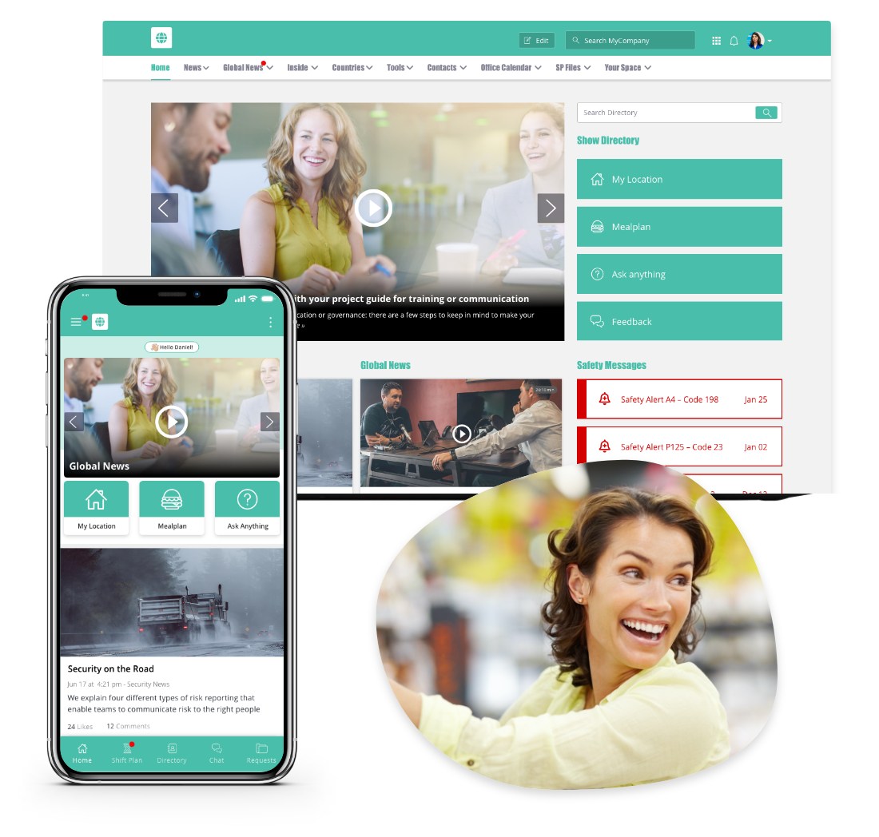
The Staffbase Employee Experience Intranet
Notes:
https://staffbase.com/en/employee-experience-intranet/

Slide 4
Poll:
Based on your own situation, how do you feel?

Slide 5
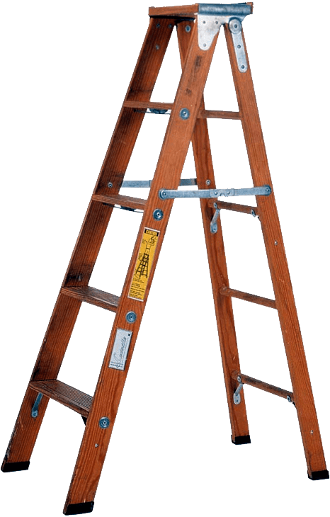
"If the ladder is not leaning against the right wall, every step we take just gets us to the wrong place faster."
-Stephen Covey

Slide 6
Roundtable Discussion...

Slide 7
Poll:
Do you feel valued as a communicator?

Slide 8
Final Discussion...

Slide 9
Poll:
Based on your own situation, how do you feel now?

Slide 10
BAD NEWS:
Imposter syndrome does not disappear with success
Katie Macaulay
Notes:
source: https://www.linkedin.com/pulse/sufferers-imposter-syndrome-least-likely-what-fear-katie-macaulay/?trackingId=wq4LxTUuRqmzXDlfv2Pgvg%3D%3D

Slide 11
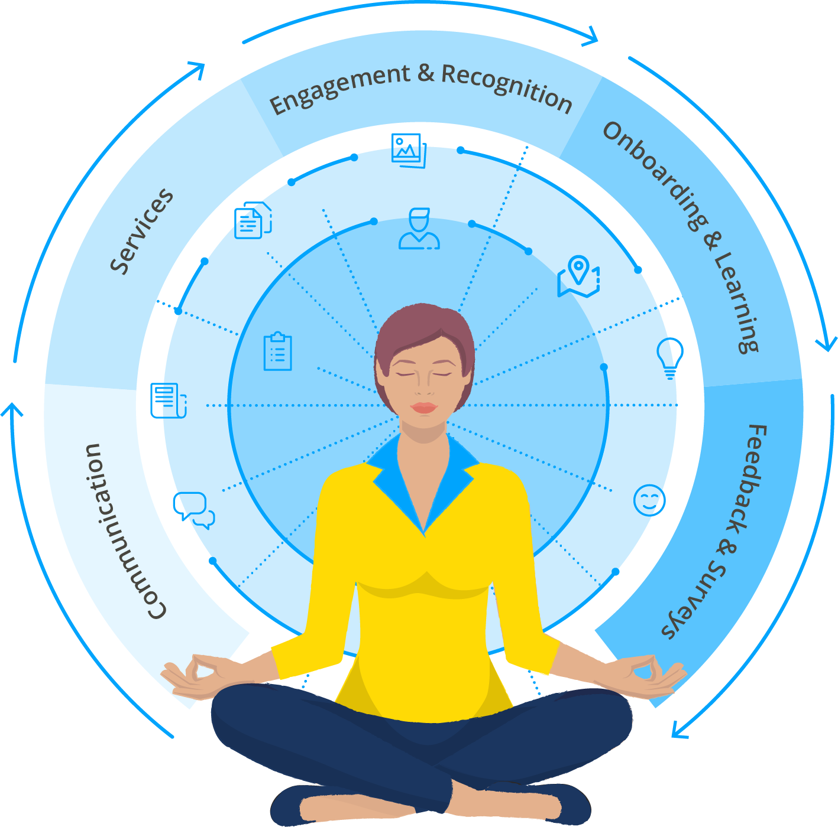
Stay Relevant with Experience-driven Communications
Own your seat or don’t sit in it.
The importance of self-doubt
You’re not perfect, and that’s perfect.
Success won’t change anything.
Constantly collect information. Plan for the debrief.
Don’t neglect yourself from yourself

Slide 12
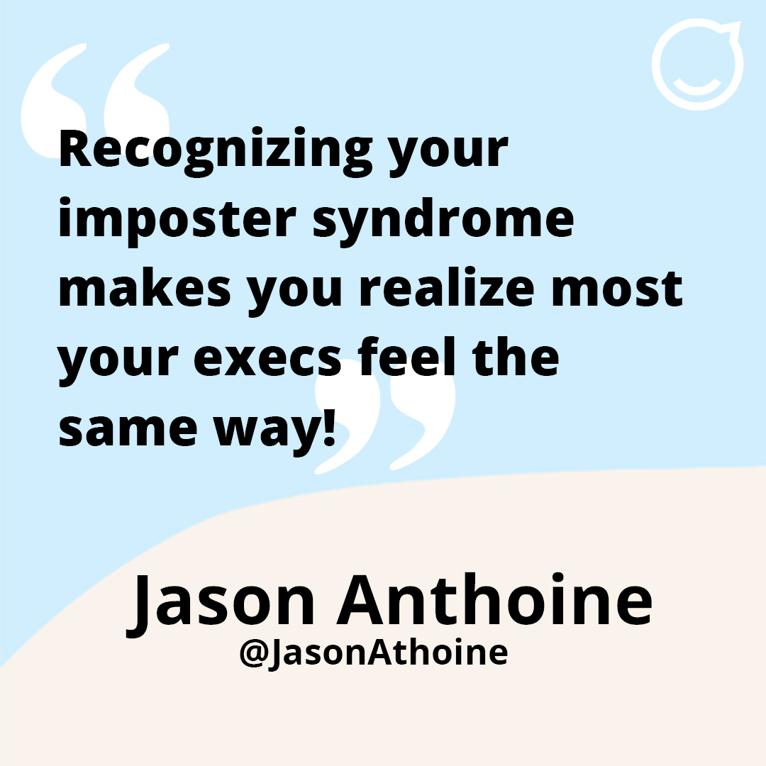
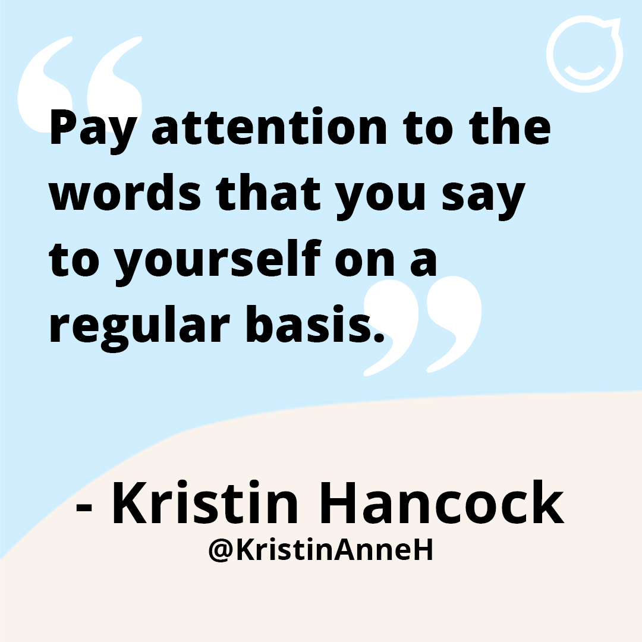
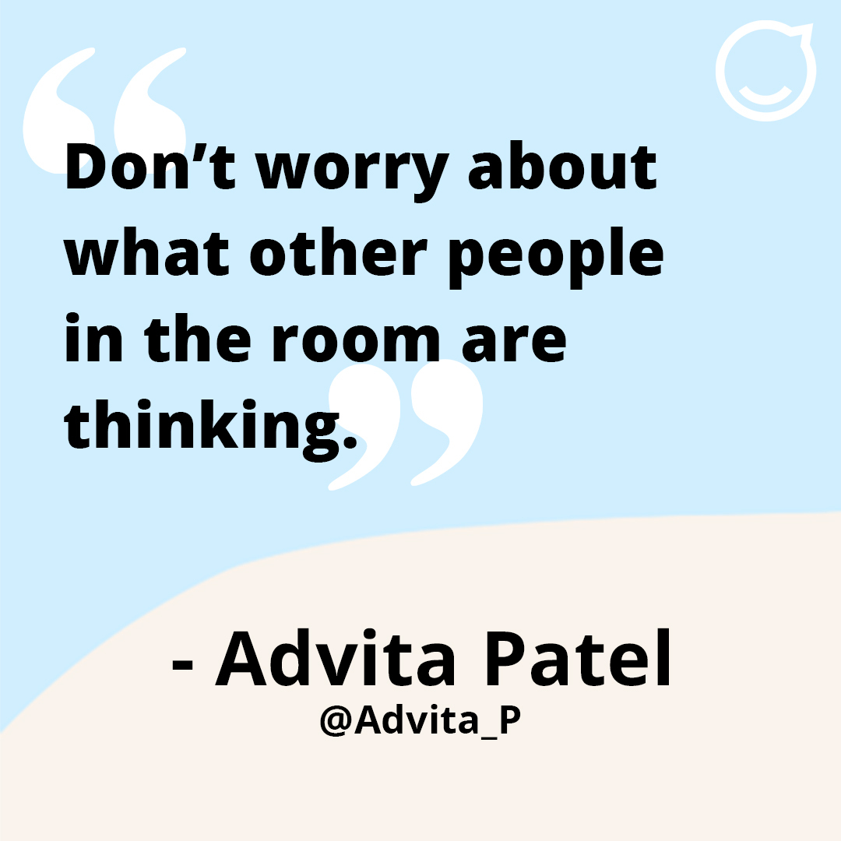
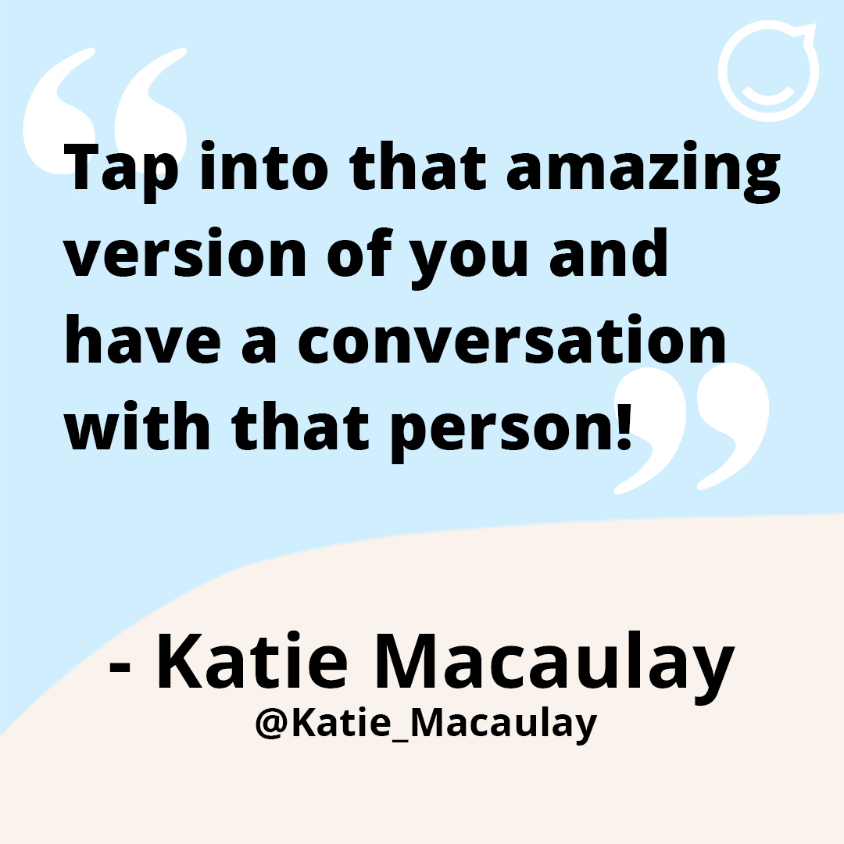
Final thoughts from Speakers...

Slide 13
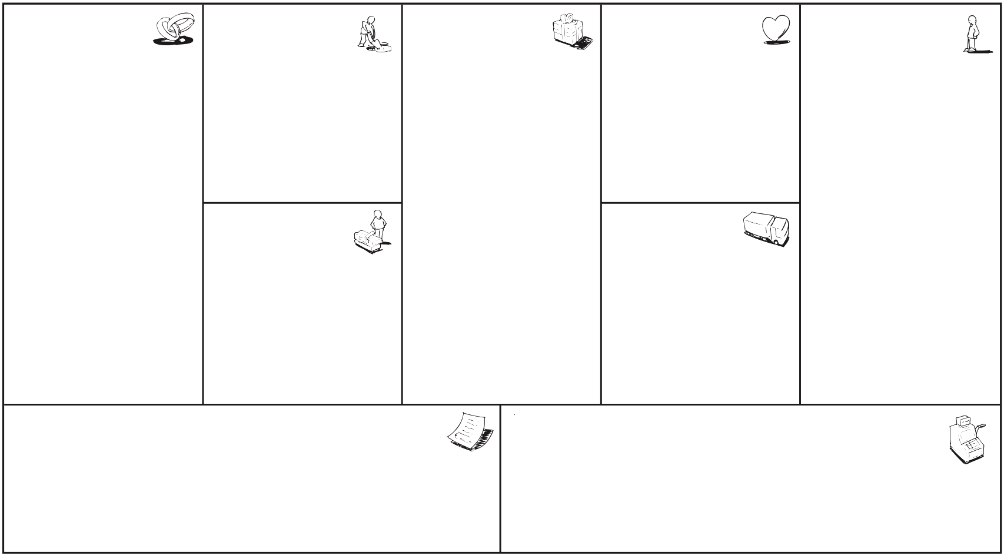
Create Your Own: The Communications Plan for the ‘New Normal’
Key Activities
What activities and campaigns can be used to deliver the message? Which non-critical activities should be stopped?
Example: Weekly status briefing, ask the CEO, Thank you channel, on-site Q&A, virtual town halls, fast feedback and response channel for health and safety issues, community building activities
Communication Goals
What are the main goals of internal communication activities? What do we want employees to do/say/feel differently?
Example:
Clarity the current situation and the planned way forward
Employees feel safe in their work environment
There is up-to-date and clear guidance about changing responsibilities, activities, and policies
High trust in leadership
Strong sense of community and shared purpose, despite widespread work from home
Stop any kind of fake news
Key Stakeholders
List of key stakeholders who need to be involved. How do their needs differ? Who can provide input? Should there be a “fast response team”?
Example: Establish higher frequency of sync meetings between Communications, HR, Corporate Health Management, Workers Council, and Management to enable quick decision making and fast learning cycles.
Key Messages + Stories
What are the main messages for all employees? What are specific messages for individual segments and personas?
Example: How do we as an organization overcome this crisis and what are the top priorities right now?
Target Personas
Who are you communicating with? How do their needs differ? Which moments matter for them?
Example: Factory workers need full understanding about health and safety measures, need easy way to ask questions and make suggestions to improve procedures at their workplace. An important moment will be the first return to their workplace after the lockdown.
Other segments: home office workers, field service staff, high risk area staff (i.e. healthcare workers), leadership, etc.
Communication
Channels
What channels will be used to communicate with which target personas? How could channels be improved to support communication goals?
Example: Intranet, employee app, digital signage. etc.
Communications
Team
What are the communications team’s key resources? How could they be extended by external help and local part-time content owners?
Example: Strengthen local content owner communities
Communications Budget
What is your communications cost structure? What changes to the budget are needed and why?
Example: Save budget on non-critical activities, faster retirement of inefficient and slow communications channels, faster launch of new digital channels.
Track Results and Measure
How do you define success? What are output and outcome metrics?
Example: Output (regular CEO status updates), outcome (pulse survey shows strong trust in leadership, low number of health and safety concerns).
Notes:
https://staffbase.com/blog/after-coronavirus-planning-for-the-new-normal-with-proactive-internal-communication-includes-free-strategy-template/

Slide 14
People-first companies win.
jason@staffbase.com

